Slide 1

K-Means Clustering And the Team Data Science Process
AML001
Notes:
Main page: http://cortanaanalytics.com
To begin this module, you should have:
Basic Math and Stats skills
Business and Domain Awareness
General Computing Background
NOTE: These workbooks contain many resources to lead you through the course, and provide a rich set of references that you can use to learn much more about these topics. If the links do not resolve properly, type the link address in manually in your web browser. If the links have changed or been removed, simply enter the title of the link in a web search engine to find the new location or a corollary reference.
https://gallery.cortanaintelligence.com/Experiment/N-Grams-and-Clustering-Find-similar-companies-Training-Exp-1
https://gallery.cortanaintelligence.com/Experiment/N-Grams-and-Clustering-Find-similar-companies-Scoring-Exp-1

Slide 2
Course Goals
Understand the Team Data Science Process, CIS Platform components, Tools installation and overview
Understand Data sourcing, Feature selection techniques, Data cataloging, Data Ingestion, Data Exploration
Understand Data selection, including Features, Dimension reduction, Data processing, Data transformation and augmentation
Determine Algorithm selection and application, Parameter selection and adjustment
Show Business validation of report and results, Model testing and cross-validation
Deploy the solution using Data Destinations, API's, or Queries and Reports
Notes:
Course Description:
In this workshop you’ll cover a series of modules that guide you from understanding an analytics workload, the Cortana Intelligence Suite Process, the foundations of data transfer and storage, data source documentation, storage and processing using many CIS-components including the Azure platform, the Azure Data Factory, HDInsight, Power BI and others. You’ll also learn how to work through a real-world scenario using the Cortana Intelligence Suite tools, including the Microsoft Azure Portal, PowerShell, and Visual Studio, among others.
Concepts Delivered:
1. The Data Science Process, CIS Platform components, Tools installation and overview
2. Data sourcing, Feature selection techniques, Data cataloging, Data Ingestion, Data Exploration
3. Data selection, including Features, Dimension reduction, Data processing, Data transformation and augmentation
4. Algorithm selection and application, Parameter selection and adjustment
5. Business validation of report and results, Model testing and cross-validation
6. Deploying the solution using Data Destinations, Deploying the solution using API's, Deploying the Solution using Queries and Reports
7. Mapping requirements to CIS solution elements, What to use When in CIS
Skills Taught:
1. Understand the CIS Process (General level), Understand CIS Components (General Level), Set up and configure the development environment
2. Source and vet proper data, Understand feature selection, Understand Azure ML Storage Options
3. Use Azure ML and create experiments
4. Evaluate the efficacy and performance of an Azure ML experiment
5. Publish an Azure ML API
6 Understand the access methods of Azure Storage and Intelligent Processing, Understand the options to send a HIVE query to an HDI system, Use Power BI to query the results of a solution and create reports in Power BI Desktop, Power BI Service, and Power BI in Microsoft Excel
7. Understand when to use each component within CIS
Technologies Covered:
1. The Data Science Process, Azure Portal, ADC Interface, Visual Studio Interface (and RTVS), Power BI Interface
Azure Machine Learning Interface, Azure PowerShell, Azure Storage Explorer
2. Azure Data Catalog, Azure Storage, Techniques for discovery
3. Azure Data Factory, HDInsight
4. Azure Machine Learning, Microsoft R Server overview, Azure Data Factory
5. Azure Machine Learning, Microsoft R Server overview, Azure Data Factory, Business Validation, SQL DB, Azure Storage
6. Azure Data Storage, SQL DB, Azure Machine Learning API, Cognitive Services API, HIVE, Power BI
7. Cortana Intelligence Process, Cortana Intelligence Suite Platform
Course Modules:
1. Process and Platform, Environment Configuration
2. Data Discovery and Ingestion
3. Data Preparation
4. Modeling for Machine Learning and Data Mining (Extended Class)
5. Business Validation and Model Evaluation (Extended Class)
6. Deploying and Accessing the Solution
7. Workshop recap (Extended Class)
Pre-Requisites:
1. A subscription to Microsoft Azure (this may be provided through your company or as part of your invitation – you *must* have this enabled prior to class. You will be using Azure throughout the course, for all labs, work and exercises. You can use your MSDN subscription (https://azure.microsoft.com/en-us/pricing/member-offers/msdn-benefits/), your employer may provide Azure resources to you, or you may receive instructions in your class invitation.
2. We’ll be using the Data Science Virtual Machine in Azure for the course. It has all of the tools you will need to work with the materials. Make sure you’re able to use the Remote Desktop Protocol (RDP) from your system to be able to work through the labs.
3. A background in data technologies, such as working with Relational and Non-Relational data processing systems
4. It’s also a good idea to have a general level of predictive and classification Statistics, and a basic understanding of Machine Learning.
5. Optional: If you would also like to work with some of the tools locally (you still need an Azure subscription for this class), you can optionally obtain:A laptop that you can install software on, Visual Studio installed – the Community Edition (free) is acceptable – Version 2015 preferable (https://www.visualstudio.com/en-us/products/visual-studio-community-vs.aspx), The Azure SDK and Command-line Tools installed (https://azure.microsoft.com/en-us/downloads/ ), The Azure Storage Explorer (http://go.microsoft.com/fwlink/?linkid=698844&clcid=0x409), Power BI Desktop Installed (https://powerbi.microsoft.com/en-us/desktop/), and Install the Microsoft R Client: http://aka.ms/rclient/download with the R tools for Visual Studio.

Slide 3
Artificial Intelligence (A-I)
The shortest distance between two points
What you use to cut a T-Bone
Manicurist’s implement
Result of an adder’s attack
Informal source of information
When an presenter freezes
Something on the back of a car
Two-wheeler you take off-road
When kickoff is scheduled at a football stadium
We think alike
Each answer is a compound word or familiar two-word phrase or name in which the first word has a long A sound and the second word has a long I sound: Transportation by track: Train Ride
Notes:
A line
Steak Knife
Nail File
Snake Bite
Grape Vine
Stage Fright
Tail Light
Trail Bike
Game time
Great Minds

Slide 4
The Data Science Process and Platform

Slide 5
The Team Data Science Process
Business Understanding
Define Objectives
Identify Data Sources
Data Acquisition and Understanding
Ingest Data
Explore Data
Modeling
Feature Selection
Create and Train Model
Deployment
Customer Acceptance
Operationalize
Testing and Validation
Update Data
Handoff
Re-train and re-score
Notes:
This process largely follows the CRISP-DM model: http://www.sv-europe.com/crisp-dm-methodology/
It also references the Cortana Intelligence process: https://azure.microsoft.com/en-us/documentation/articles/data-science-process-overview/
A complete process diagram is here: https://azure.microsoft.com/en-us/documentation/learning-paths/cortana-analytics-process/
Some walkthrough’s of the various services: https://azure.microsoft.com/en-us/documentation/articles/data-science-process-walkthroughs/
An integrated process and toolset allows for a more close-to-intent deployment
Iterations are required to close in on the solution – but are harder tio management and monitor
Data Science Blog: https://buckwoody.wordpress.com/

Slide 6
The Cortana Intelligence Platform
Cortana, Cognitive Services, Bot Framework
Power BI
HDInsight
Stream Analytics
Azure Machine Learning (MRS)
SQL Data Warehouse (SQL DB, Document DB)
Data Lake
Event Hubs
Data Factory
Data Catalog
Microsoft Azure
Notes:
Platform and Storage: Microsoft Azure – http://microsoftazure.com Storage: https://azure.microsoft.com/en-us/documentation/services/storage/ (Host It)
Azure Data Catalog: http://azure.microsoft.com/en-us/services/data-catalog (Doc It)
Azure Data Factory: http://azure.microsoft.com/en-us/services/data-factory/ (Move It)
Azure Event Hubs: http://azure.microsoft.com/en-us/services/event-hubs/ (Bring It)
Azure Data Lake: http://azure.microsoft.com/en-us/campaigns/data-lake/ (Store It)
Azure DocumentDB: https://azure.microsoft.com/en-us/services/documentdb/ , Azure SQL Data Warehouse: http://azure.microsoft.com/en-us/services/sql-data-warehouse/ (Relate It)
Azure Machine Learning: http://azure.microsoft.com/en-us/services/machine-learning/ (Learn It)
Azure HDInsight: http://azure.microsoft.com/en-us/services/hdinsight/ (Scale It)
Azure Stream Analytics: http://azure.microsoft.com/en-us/services/stream-analytics/ (Stream It)
Power BI: https://powerbi.microsoft.com/ (See It)
Cortana: http://blogs.windows.com/buildingapps/2014/09/23/cortana-integration-and-speech-recognition-new-code-samples/ and https://blogs.windows.com/buildingapps/2015/08/25/using-cortana-to-interact-with-your-customers-10-by-10/ and https://developer.microsoft.com/en-us/Cortana (Say It)
Cognitive Services: https://www.microsoft.com/cognitive-services
Bot Framework: https://dev.botframework.com/
All of the components within the suite: https://www.microsoft.com/en-us/server-cloud/cortana-intelligence-suite/what-is-cortana-intelligence.aspx
What can I do with it? https://gallery.cortanaintelligence.com/
Getting Started Quickly: https://caqs.azure.net/#gallery

Slide 7
Data
Information
Discovery
Understanding
Answers

Slide 8
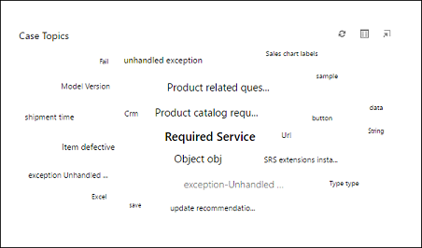
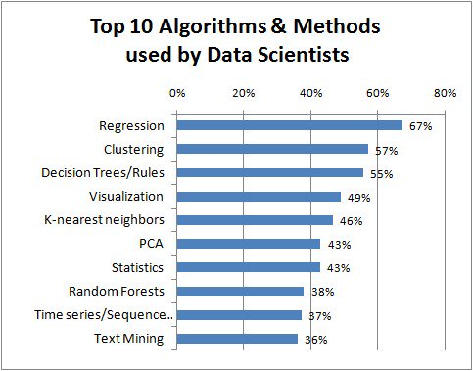
Defining the Problem and Selecting the Methods
Notes:
Figuring out the problem to solve: https://buckwoody.wordpress.com/2015/12/30/the-hardest-thing-in-data-science/
Choosing the solution elements: https://buckwoody.wordpress.com/2016/05/16/the-cortana-intelligence-suite-what-to-use-when/
Selecting Kmeans – another example, this one using images: https://www.ics.uci.edu/~dramanan/teaching/ics273a_winter08/projects/avim_report.pdf
Top algorithms as reported by KDNuggets: http://www.kdnuggets.com/2017/01/great-collection-clean-machine-learning-algorithms.html

Slide 9
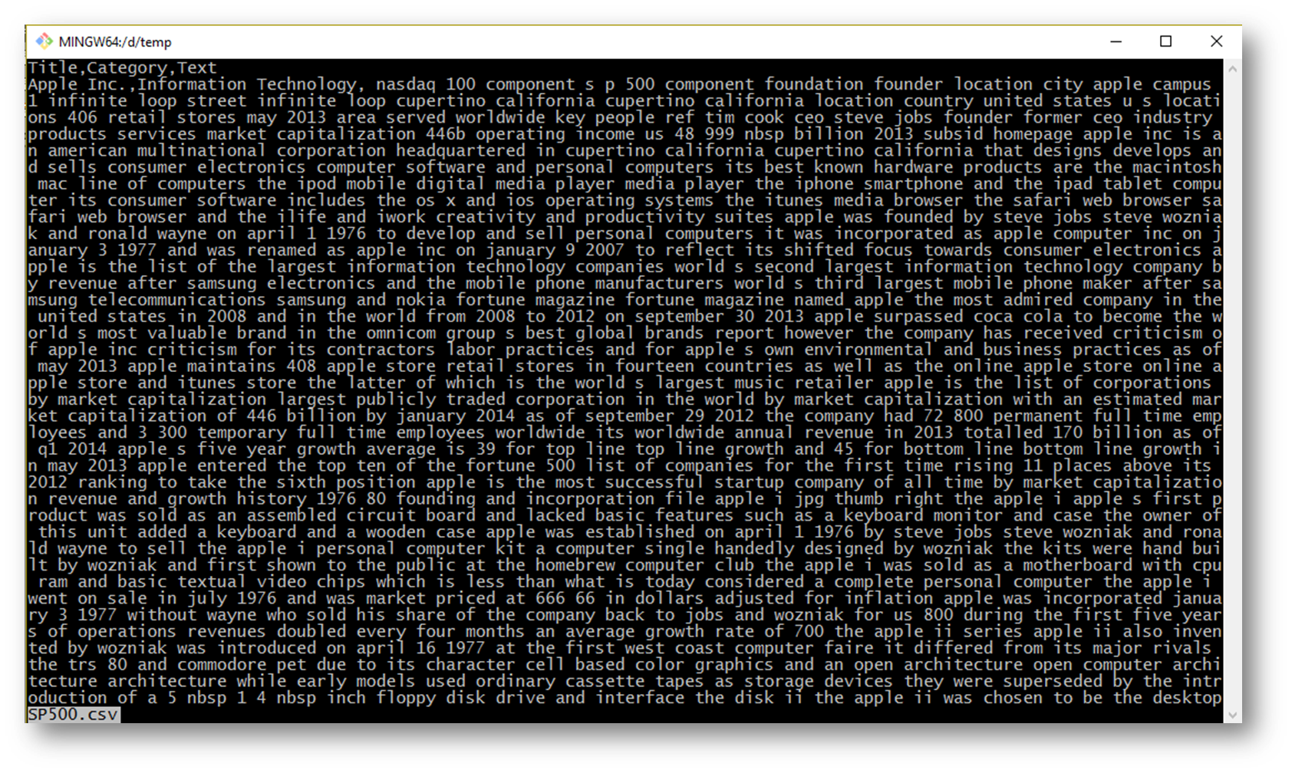
Data Sourcing and Examination
Notes:
Exploring Data - http://www.cedar.buffalo.edu/~srihari/CSE626/Lecture-Slides/Ch3-part1.pdf
General Data Location: https://www.quandl.com/
Our World in Data: https://ourworldindata.org/
Open Data Sources: http://www.opendata500.com/us/list/
Curated Data Sources: http://www.mosaicdatascience.com/data-sources/
NASDAQ Data: http://www.nasdaqtrader.com/trader.aspx?id=symboldirdefs
Data.gov http://data.gov
Open Data Network: https://www.opendatanetwork.com/
European Union European Union Open Data Portal: https://data.europa.eu/euodp/en/data/
A list of data sources: http://www.forbes.com/sites/bernardmarr/2016/02/12/big-data-35-brilliant-and-free-data-sources-for-2016/#5fd6b9d16796
Facebook API: https://developers.facebook.com/docs/graph-api/overview/

Slide 10
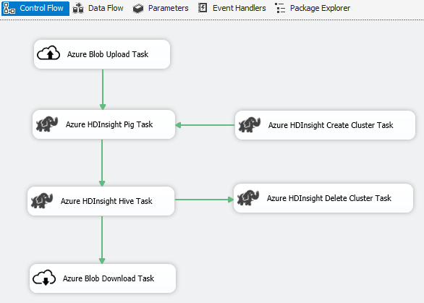
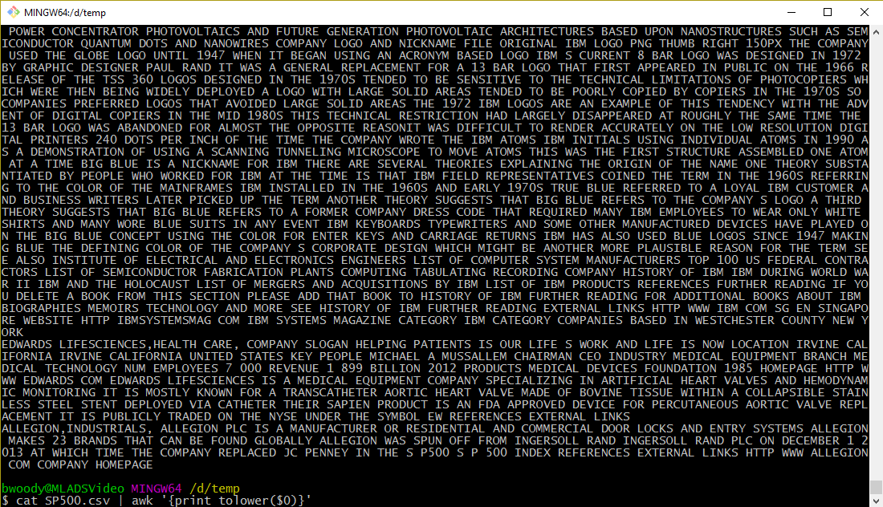
Data Wrangling
Notes:
Chapter on using secondary sources of data: http://www.fao.org/docrep/w3241e/w3241e03.htm
SSIS Feature Pack: https://msdn.microsoft.com/en-us/library/mt146770.aspx

Slide 11
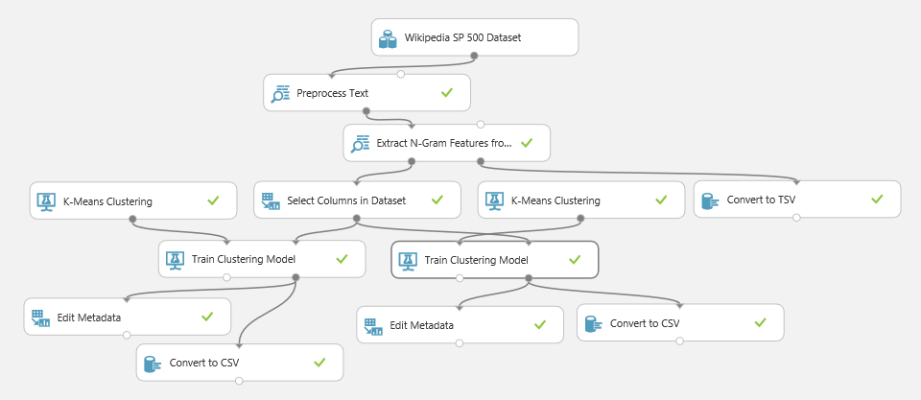
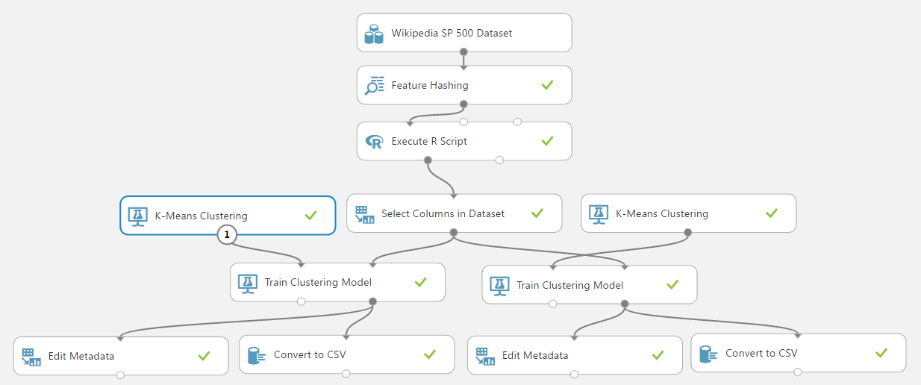
Creating the Model
Notes:
Experiment documentation: https://gallery.cortanaintelligence.com/Experiment/clustering-find-similar-companies-23
Feature Hashing module in Azure ML: https://msdn.microsoft.com/library/azure/c9a82660-2d9c-411d-8122-4d9e0b3ce92a
Understanding Vowpal Wabbit in Azure ML: https://msdn.microsoft.com/en-us/library/azure/mt674683
Options for feature reduction
Remove
Stepwise selection – Remove and Add features until they add no further value
Random Forest – Using a predictive model to get collinear variates
Subset selection - Domain knowledge needed
Least absolute shrinkage and selection operator (lasso) -
Condense
Homogeneity between columns, not rows
PCA - A thorough tutorial on PCA: http://www.cs.otago.ac.nz/cosc453/student_tutorials/principal_components.pdf
Maps are one example of feature reduction
K-Means Clustering: https://msdn.microsoft.com/library/azure/5049a09b-bd90-4c4e-9b46-7c87e3a36810
We then found issues with the results – too “brittle” for the PCA portion. So we re-wrote the experiment:
https://michhar.github.io/posts/a-python-flask-webapp-gets-smart
https://gallery.cortanaintelligence.com/Experiment/N-Grams-and-Clustering-Find-similar-companies-Training-Exp-1
https://gallery.cortanaintelligence.com/Experiment/N-Grams-and-Clustering-Find-similar-companies-Scoring-Exp-1

Slide 12
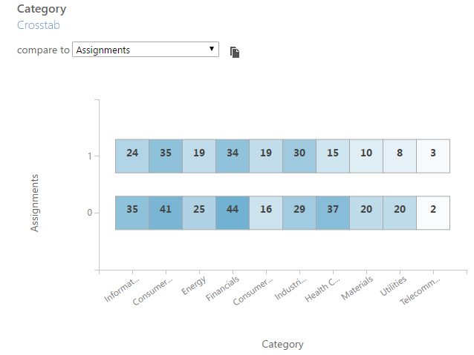
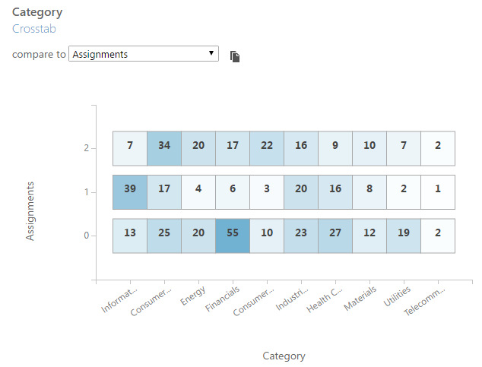
Validating the results
2 Centroids
3 Centroids
Notes:
Choosing centroids: http://nlp.stanford.edu/IR-book/html/htmledition/k-means-1.html

Slide 13
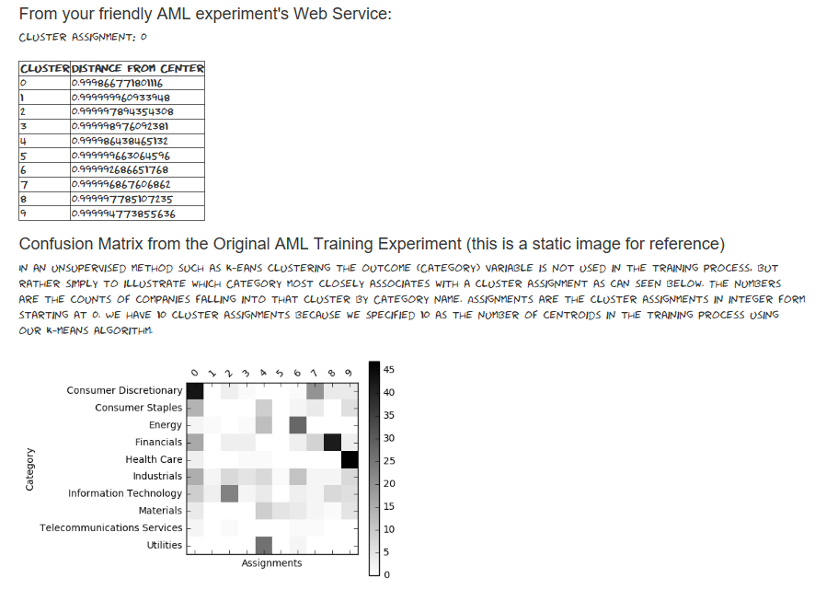
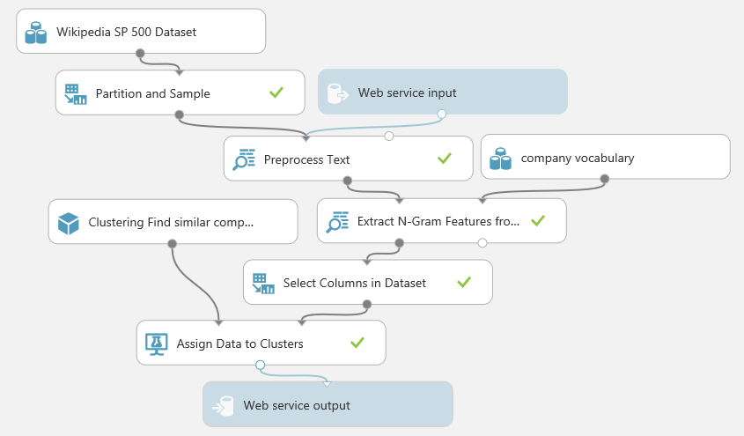
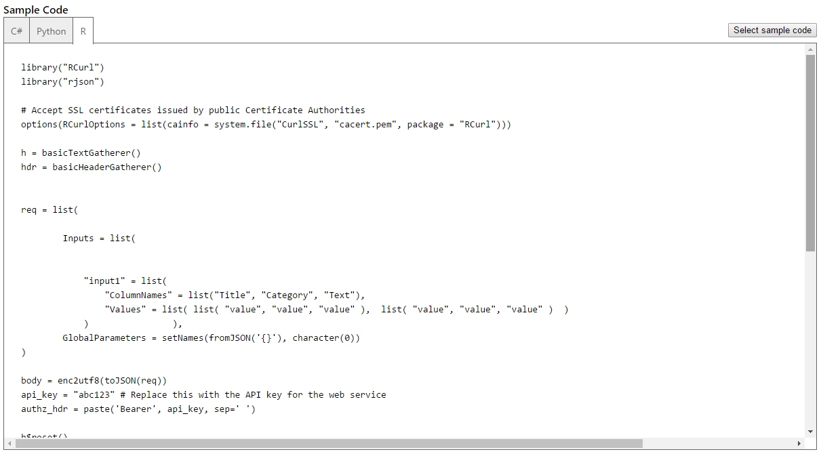
Operationalizing the Model
Notes:
Deploying a model may take many forms – including reporting, API’s and others

Slide 14
The Team Data Science Process
Business Understanding
Define Objectives
Identify Data Sources
Data Acquisition and Understanding
Ingest Data
Explore Data
Modeling
Feature Selection
Create and Train Model
Deployment
Customer Acceptance
Operationalize
Testing and Validation
Update Data
Handoff
Re-train and re-score
Notes:
This process largely follows the CRISP-DM model: http://www.sv-europe.com/crisp-dm-methodology/
It also references the Cortana Intelligence process: https://azure.microsoft.com/en-us/documentation/articles/data-science-process-overview/
A complete process diagram is here: https://azure.microsoft.com/en-us/documentation/learning-paths/cortana-analytics-process/
Some walkthrough’s of the various services: https://azure.microsoft.com/en-us/documentation/articles/data-science-process-walkthroughs/
An integrated process and toolset allows for a more close-to-intent deployment
Iterations are required to close in on the solution – but are harder tio management and monitor
Data Science Blog: https://buckwoody.wordpress.com/

Slide 15
The Cortana Intelligence Platform
Cortana, Cognitive Services, Bot Framework
Power BI
HDInsight
Stream Analytics
Azure Machine Learning (MRS)
SQL Data Warehouse (SQL DB, Document DB)
Data Lake
Event Hubs
Data Factory
Data Catalog
Microsoft Azure
Notes:
Platform and Storage: Microsoft Azure – http://microsoftazure.com Storage: https://azure.microsoft.com/en-us/documentation/services/storage/ (Host It)
Azure Data Catalog: http://azure.microsoft.com/en-us/services/data-catalog (Doc It)
Azure Data Factory: http://azure.microsoft.com/en-us/services/data-factory/ (Move It)
Azure Event Hubs: http://azure.microsoft.com/en-us/services/event-hubs/ (Bring It)
Azure Data Lake: http://azure.microsoft.com/en-us/campaigns/data-lake/ (Store It)
Azure DocumentDB: https://azure.microsoft.com/en-us/services/documentdb/ , Azure SQL Data Warehouse: http://azure.microsoft.com/en-us/services/sql-data-warehouse/ (Relate It)
Azure Machine Learning: http://azure.microsoft.com/en-us/services/machine-learning/ (Learn It)
Azure HDInsight: http://azure.microsoft.com/en-us/services/hdinsight/ (Scale It)
Azure Stream Analytics: http://azure.microsoft.com/en-us/services/stream-analytics/ (Stream It)
Power BI: https://powerbi.microsoft.com/ (See It)
Cortana: http://blogs.windows.com/buildingapps/2014/09/23/cortana-integration-and-speech-recognition-new-code-samples/ and https://blogs.windows.com/buildingapps/2015/08/25/using-cortana-to-interact-with-your-customers-10-by-10/ and https://developer.microsoft.com/en-us/Cortana (Say It)
Cognitive Services: https://www.microsoft.com/cognitive-services
Bot Framework: https://dev.botframework.com/
All of the components within the suite: https://www.microsoft.com/en-us/server-cloud/cortana-intelligence-suite/what-is-cortana-intelligence.aspx
What can I do with it? https://gallery.cortanaintelligence.com/
Getting Started Quickly: https://caqs.azure.net/#gallery

Slide 16
© 2014 Microsoft Corporation. All rights reserved.

